Slide 1
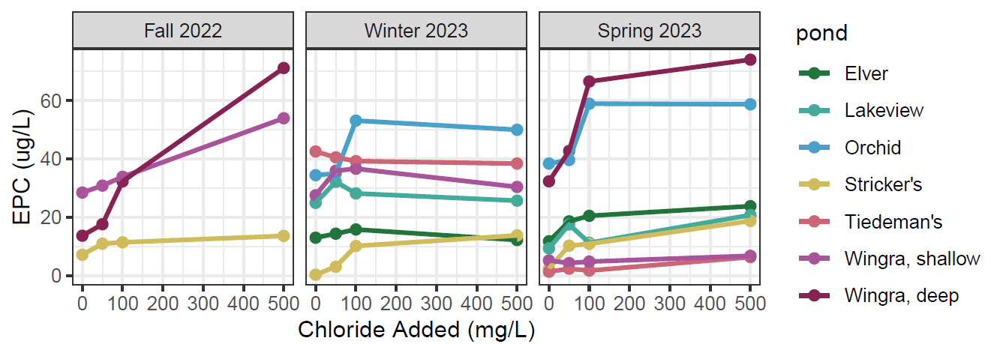
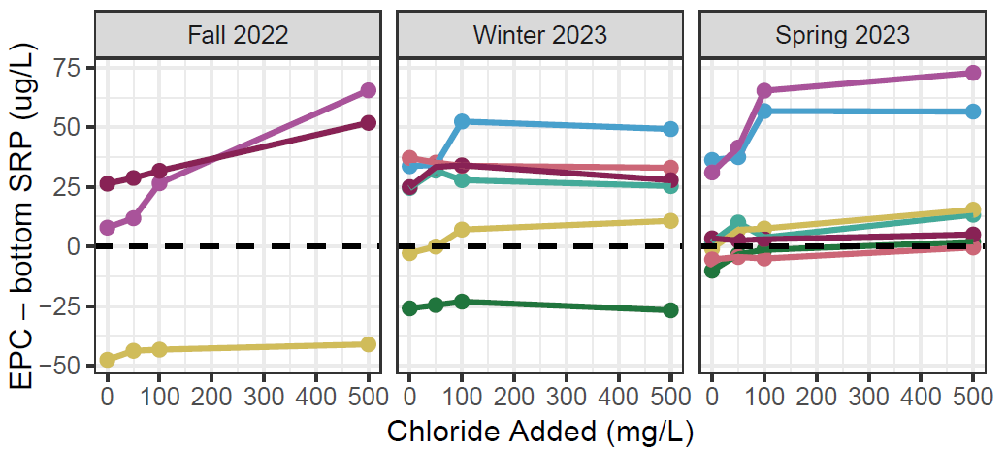
A
B
C
D
E
F
D
E
F
EPC > bottom SRP Desorption favored Sediments P source
6.5 x 2.34
EPC < bottom SRP Adsorption favored Sediments P sink

Slide 2
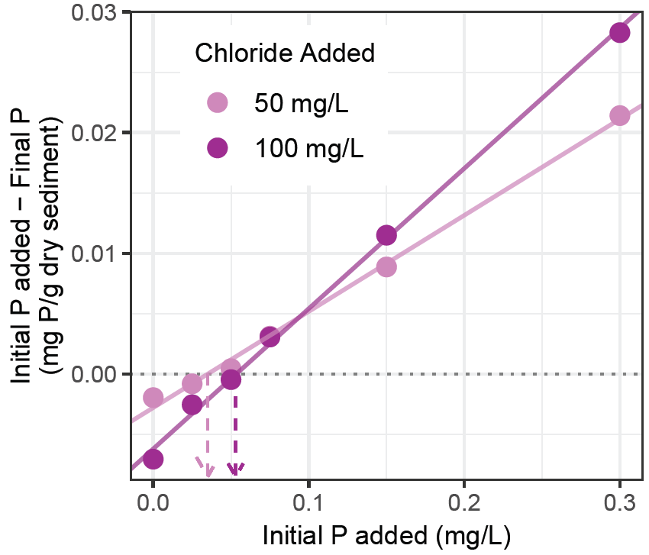
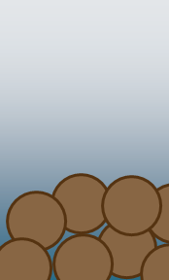
A. Chloride & P Treatments
B. How EPC is calculated
More P in solution after incubation in the higher chloride treatment
C. Interpretation of EPC
0 mg/L chloride
SRP in overlying water: 30 µg L⁻¹
SRP in overlying water: 50 µg L⁻¹
SRP in overlying water: 10 µg L⁻¹
SRP in overlying water: 10 µg L⁻¹
0 µg/L P added
25 µg/L P added
50 µg/L P added
75 µg/L P added
150 µg/L P added
300 µg/L P added
P
P
P
P
P
P
P
50 mg/L chloride
0 µg/L P added
25 µg/L P added
50 µg/L P added
75 µg/L P added
150 µg/L P added
300 µg/L P added
P
P
P
P
P
P
P
100 mg/L chloride
EPC = 30 µg L⁻¹
EPC = 30 µg L⁻¹
EPC = 30 µg L⁻¹
EPC = 50 µg L⁻¹
0 µg/L P added
25 µg/L P added
50 µg/L P added
75 µg/L P added
150 µg/L P added
300 µg/L P added
SRP in the overlying water is at equilibrium with the capacity of the sediment to sorb loosely-bound P, concentrations in water do not change
Sediments as a P sink: SRP in the overlying water is greater than capacity of the sediment to sorb loosely-bound P, adsorption favored
Sediments as a P source: SRP in the overlying water is less than the capacity of the sediments to sorb loosely-bound P, desportion favored
Increasing EPC means the sediment is more likely to become a source of SRP or a larger source of SRP to the overlying water
More P desorbs from the sediment in the higher chloride treatment
500 mg/L chloride
0 µg/L P added
25 µg/L P added
50 µg/L P added
75 µg/L P added
150 µg/L P added
300 µg/L P added
The concentration at which the sediments are in equilibrium with the water (EPC) is greater in the higher chloride treatment

Slide 3
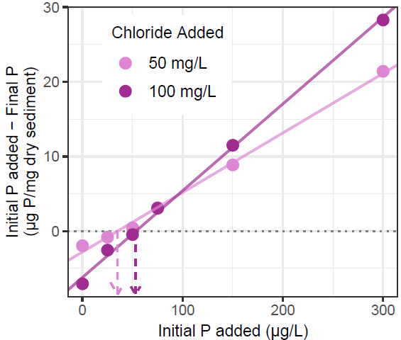
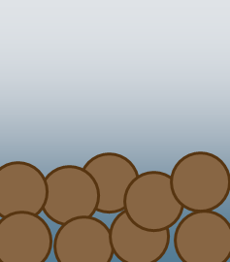
A. Experimental Set Up
B. How EPC is calculated
More P in solution after incubation with 100 mg/L chloride
50 mg/L chloride
100 mg/L chloride
0 µg/L P added
25 µg/L P added
50 µg/L P added
0 µg/L P added
25 µg/L P added
50 µg/L P added
75 µg/L P added
150 µg/L P added
300 µg/L P added
75 µg/L P added
150 µg/L P added
300 µg/L P added
Conc. of P when sediments are in equilibrium with the water (EPC) is greater at 100 mg/L chloride
More P desorbed from sediment in 100 mg/L chloride
C. Interpretation of EPC
SRP in overlying water: 30 µg L⁻¹
SRP in overlying water: 50 µg L⁻¹
SRP in overlying water: 10 µg L⁻¹
SRP in overlying water: 10 µg L⁻¹
P
P
P
P
P
P
equilibrium
P
adsorption
desorption
greater desorption
P
P
P
P
P
P
P
EPC = 30 µg L⁻¹
EPC = 30 µg L⁻¹
EPC = 30 µg L⁻¹
EPC = 50 µg L⁻¹
SRP in the overlying water is at equilibrium with the capacity of the sediment to sorb loosely-bound P, concentrations in water do not change
Sediments as a P sink: SRP in the overlying water is greater than capacity of the sediment to sorb loosely-bound P, adsorption favored
Sediment as a P source: SRP in the overlying water is less than the capacity of the sediments to sorb loosely-bound P, desportion favored
Increasing EPC means the sediment is more likely to become a source of SRP or a larger source of SRP to the overlying water

